Slide 1
News Recommendation System
Developed and Presented by:
Manish Kharel (20912/075)
Sabina Kumari Karki (20922/075)
Saraswati Niroula(20926/075)

Slide 2
Introduction
System used to recommend news to the user
Recommended is generated based on the user's preferences
User's interactions such as likes and comments are used further recommendation
Help users to navigate vast amount of news content available
Intends to improve overall news reading experience

Slide 3
Problem Statement
Difficulty in finding relevant topics from online news sources
Overwhelming volume of articles on news websites makes it challenging for users to find interesting reads
Finding relevant and preferred news is time-consuming
Traditional news recommendation system lacks personalization
Poor user experience and low engagement

Slide 4
Objectives
Design and develop personalized news recommendation system
System that predicts the news that an individual is most likely to find informative
Recommendation generation based on past interactions and preferences
Adapt to the changing interests and preferences of each user over time
Improve the user experience and increase engagement with the recommended content

Slide 5
Scope and Limitations
Scope
Limitations
User Profiling
Recommendation algorithm
Recommendation generation
Real-time updates
User interaction
Cold start problem
Sparsity of data
Lack of contextual information
Over-reliance on popularity bias

Slide 6
Literature Review
Social media platform
Various platforms have implemented recommendation systems to enhance user engagement.
YouTube utilizes a hybrid recommendation approach based on collaborative and content-based recommendations.
Personalized News Recommendation:
Research introduces personalized recommendation technology to news systems.
Hybrid collaborative filtering algorithm improves recommendation accuracy and stability.
Advantages of Collaborative Filtering:
Collaborative filtering is advantageous for recommender systems, requiring only ratings for recommendations.
Memory-based and model-based approaches address the limitations of collaborative filtering.

Slide 7
Literature Review
E-commerce Recommendation Systems:
E-commerce sites widely use recommendation systems for various products.
Content-based, collaborative, and hybrid approaches have pros and cons.
Amazon and Google News:
Amazon leverages a recommendation algorithm for product suggestions.
Google News uses popularity-based recommendations and filters top news.
Proactive Mobile News Recommendation:
A system proactively pushes personalized news articles to mobile users based on contextual information.
Analytic Hierarchy Process (AHP) model rates the relevance of news articles.

Slide 8
Functional Requirement
User registration and login
Personalization
Recommendation generation
News tracking
News categorization
User feedback

Slide 9
Non-Functional Requirement
Performance
Scalability
Reliability
Security
Usability
Maintainability

Slide 10
Feasibility Study
Technical Feasibility
Operational Feasibility
Economic Feasibility
Schedule Feasibility

Slide 11
Algorithm Details (Collaborative Filtering)
Process of filtering items using the opinions of others
Performs filtering of data based on behaviour of user
Matrix Factorization
Technique used to make personalized recommendation to users based on interactions and behaviour of similar users
Tries to characterize both items and users by their feature vectors

Slide 12
Algorithm Details (Collaborative Filtering)
Cosine similarity
Is a metric used to measure how similar two items are
Measures cosine angle between two vector projected
The output value ranges from 0-1.
0 means no similarity and1 means that both the items are 100% similar.
Where,
u. v = product (dot) of the vector ‘u’ and ‘v’.
||u|| and ||v|| = length of the two vectors ‘u’ and ‘v’.
||u|| * ||v|| = cross product of the two vectors ‘u’ and ‘v’.

Slide 13
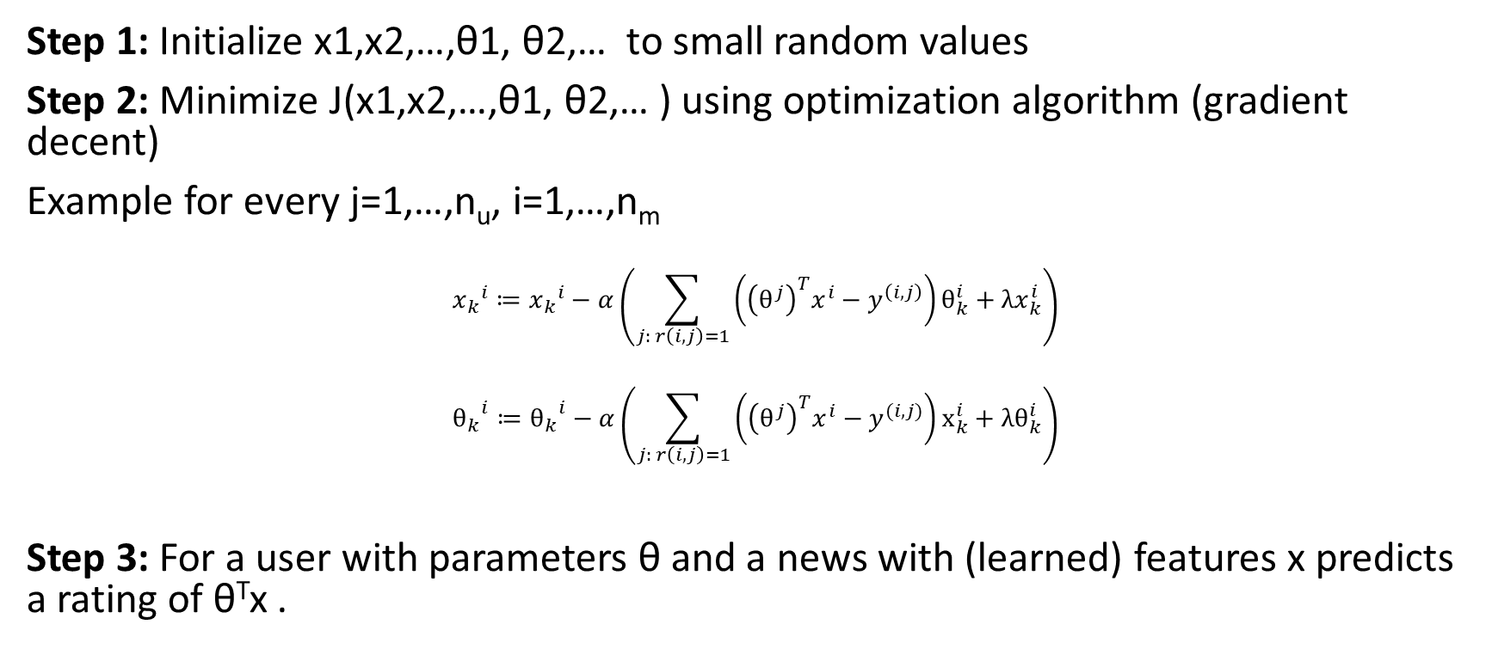
Algorithm Details (Collaborative Filtering)
Step 1: Initialize x1,x2,…,θ1, θ2,… to small random values
Step 2: Minimize J(x1,x2,…,θ1, θ2,… ) using optimization algorithm (gradient decent)
Example for every j=1,…,n_{u}, i=1,…,n_{m}
$${x_{k}}^{i}≔{x_{k}}^{i}−α\left(\sum_{j: r\left(i,j\right)=1}{\left({\left(θ^{j}\right)}^{T}x^{i}−y^{\left(i,j\right)}\right)θ_{k}^{i}+λx_{k}^{i}}\right)$$
$${θ_{k}}^{i}≔{θ_{k}}^{i}−α\left(\sum_{j: r\left(i,j\right)=1}{\left({\left(θ^{j}\right)}^{T}x^{i}−y^{(i,j)}\right)x_{k}^{i}+λθ_{k}^{i}}\right)$$
Step 3: For a user with parameters θ and a news with (learned) features x predicts a rating of θ^{T}x .

Slide 14
Implementation Details
Tools used
Draw.io, LucidChart
GitHub
DVC
Visual Studio Code
Google Collab
Programming Language
Python
ReactJs
HTML and CSS
Sklearn
Numpy
Pandas
Matplotlib
torch

Slide 15
Implementation Details
Build CF Model
First, we developed the CF Model having the arguments: embedding vars, loss, metrics
Then we initialized embedding using normal distribution
Train Function
To train the CF model we developed a train function having arguments: model, rating_mat and optimizer.
This function returns the calculated loss during the training
Test Function
To test the CF model, we developed a test function having arguments: iterations, learning_rate, plot_results, optimizer.
This function returns the metrics dictionary evaluated at the last iteration.

Slide 16
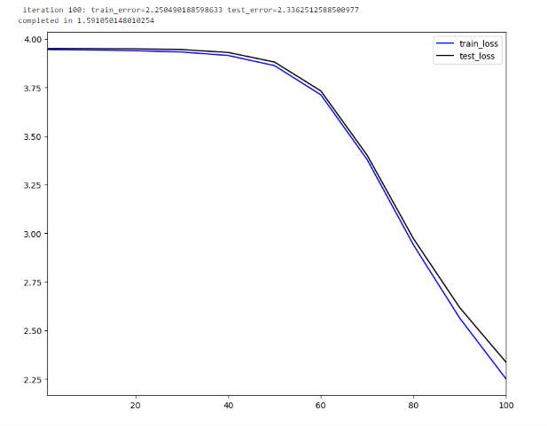
Result Analysis
Training model without using regularization

Slide 17
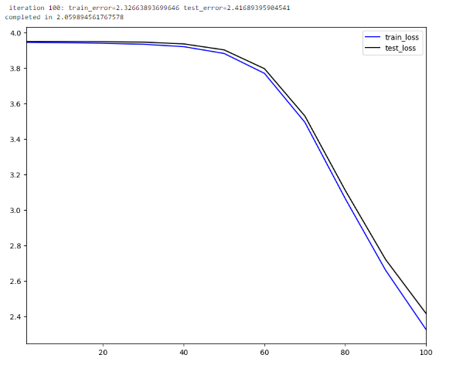
After using l2 regularization with Regularization coefficient = 0.1 Gravity coefficient = 1.0

Slide 18
Taking Embedding dimension:15 Standard deviation:0.05 Number of iterations:100 Learning Rate: 10.0

Slide 19
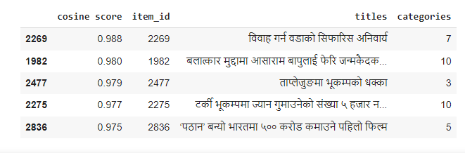
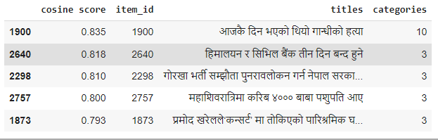
For user 7171
For user 2023

Slide 20
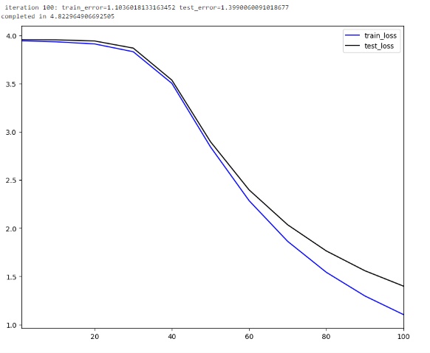
Taking Embedding dimension: 40 Standard deviation: 0.05 Number of iterations: 100 Learning Rate: 15.0

Slide 21
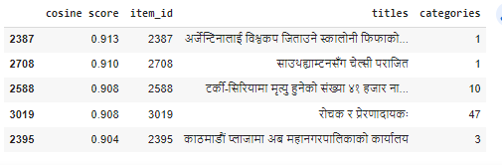
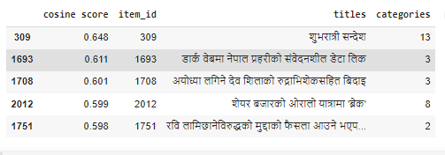
For user 7171
For user 2023

Slide 22
Future Recommendation
NLP-based Recommendation
Demographic-Based Recommendation
Consider Additional factors
Improve Personalized
Explore Hybrid Approaches
Enhance User Engagement
Adaptive Learning

Slide 23
Conclusion
The system successfully recommends news articles to individual user preferences and interests.
The system has been rigorously tested and evaluated using metrics like train and test errors to ensure its accuracy and effectiveness.
The system is designed to handle large amounts of data and users, making it scalable for future growth and adaptable to different platforms and portals.
The system can be easily integrated as a microservice into existing news portals, seamlessly enhancing the user experience.

Slide 24
Thank You

